Slide 1
VLA-R3L: achieving performant robotic generalist policy in real world via reflective residual reinforcement learning
Leveraging on the reinforcement learning towards residual to optimize the performance and precision of action trunk generated by diffusion policy
Ziming Yan 18/01/2026

Slide 2
Recent Works
Paper Review
Steering Your Diffusion Policy with Latent Space Reinforcement Learning (DSRL)
Diffusion Policy Policy Optimization (DPPO)
Reinforcement Learning with Action Chunking (Q-chunking)
Beginning of DSRL Reproduction
Codebase Structural Analysis
Infrastructure Preparation

Slide 3
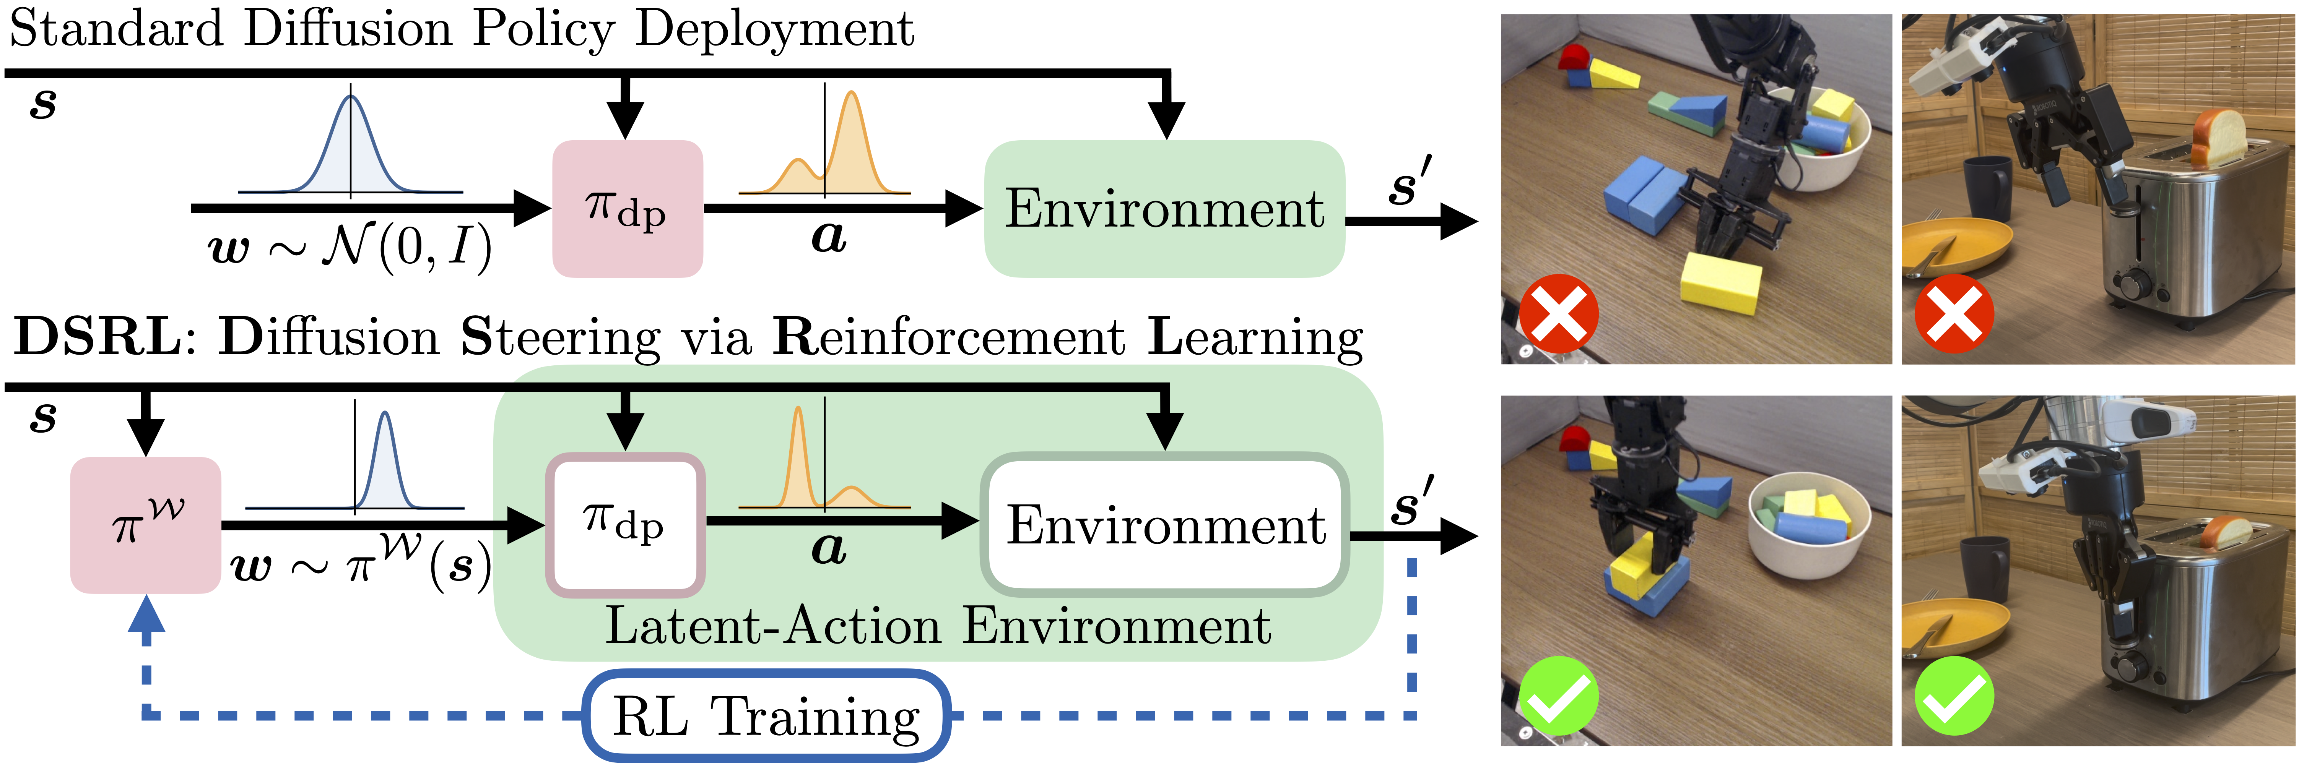
Recent Works
Use the Latent-Action Environment mechanism to convert the action trunk selection problem into noise distribution selection (Wagenmaker et al., 2024).

Slide 4
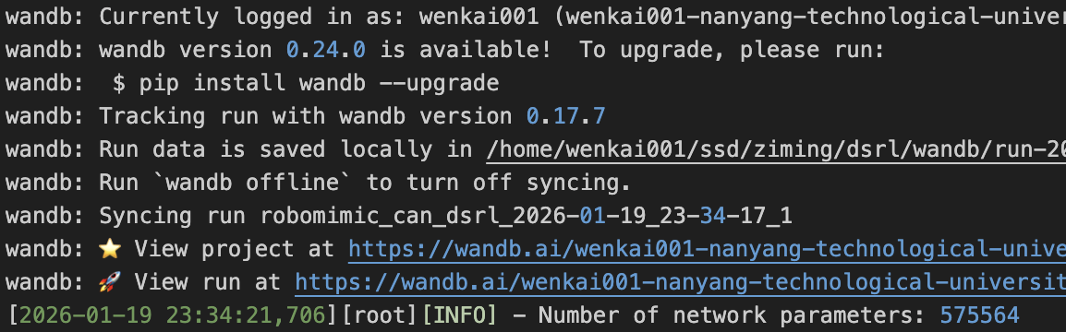
Recent Works
Accomplish:
Basically finish the environment development
conda env python 3.9
robomimic
gym
Obstacles:
Original robomimic can demon video missing

Slide 5
Future Works
Short-term Milestone (1-2 weeks):
Finish Code Reproduction:
Run DSRL on Robomimic simulation benchmarks to establish performance
Theoretical Reinforcement:
Intensive study of basic RL knowledge, like Markov Decision Process (MDP) and PPO
Reading more related papers
Long-term Milestone:
Design an appropriate off-line RL method that enables residual optimization of agent actions
Incorporating reflective thinking into the RL process

